Slide 1
CIS-2423 PROJECT
Student Name(s): | Ayesha Naser Almansoori | Huda Omar Alreyashi | Shamma Mohammed Alhammadi
Student HCT ID(s): | H00531535 | H00502272 | H00472255

Slide 2
Lecture Outline
Section I
Section III
Section II
Section IIII

Slide 3
Section I
We analyzed the Global AI Content Impact Dataset to determine how AI Adoption Rate (%) affects Job Loss Due to AI (%) across countries and sectors. Using Python for data analysis and regression. Later we introduced other independent variables such as Human-AI Collaboration Rate (%) and Consumer Trust in AI (%) since multiple input variables are needed for Multiple Linear Regression. These were selected due to their relevance in determining the way AI impacts employment and towards identifying wider trends and aiding data-driven decision-making on AI's role in the labor force.

Slide 4
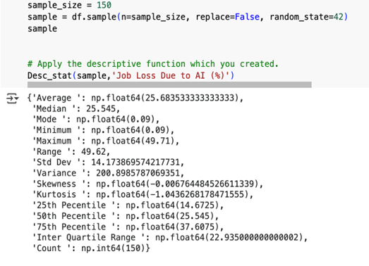
Section II
We applied a dedicated Python function, `Desc_Stat`, to compute significant descriptive statistics such as mean and standard deviation for Job Loss Due to AI (%) in a sample of 150 observations to discern data trends prior to regression analysis.

Slide 5
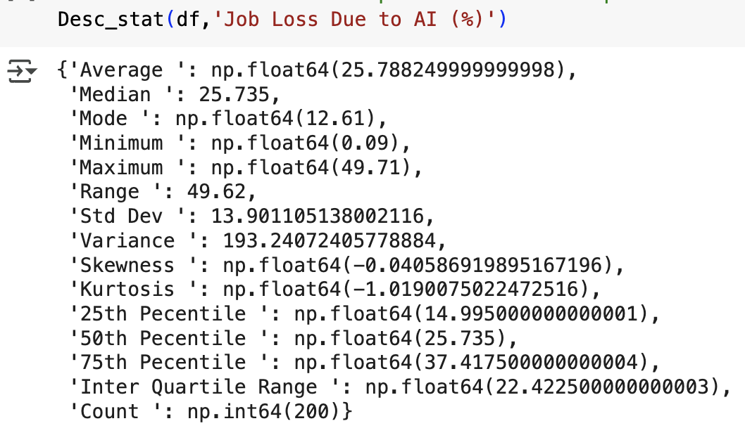

Section II
Using the `Desc_Stat` function, we found Job Loss Due to AI (%) to be 25.79 on average, essentially the same median, low standard deviation (13.90), and wide range, which suggests different but fairly symmetrical data. We also used graphical aids like scatter plots, box plots, histograms, and heatmaps to review patterns, outliers, distribution, and correlations for additional insight.

Slide 6
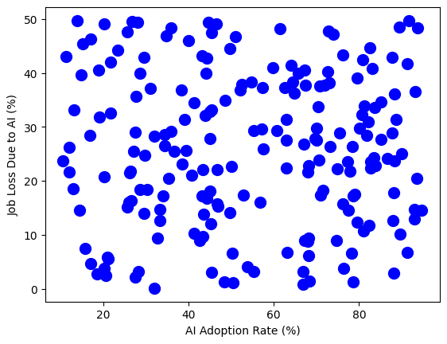
Section II
We used scatter plots, box plots, histograms, and heatmaps to graph Job Loss Due to AI (%), and thus identify relationships, detect outliers, measure distribution, and examine variable correlation.
The scatter plot reveals that there is no high linear correlation between Job Loss Due to AI and AI Adoption Rate, and therefore more or less job loss is not always caused by more AI adoption.

Slide 7
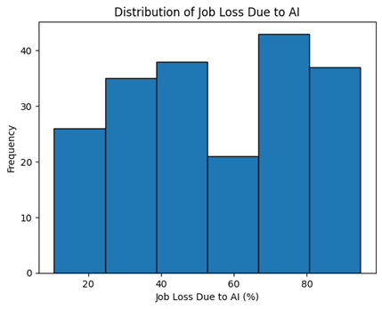
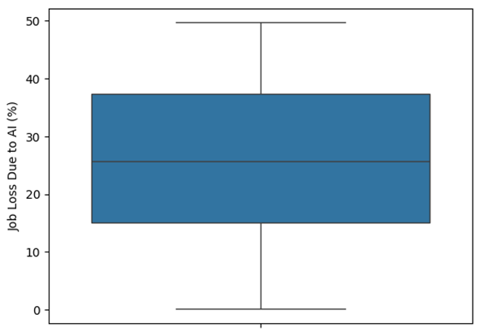
Section II
BOX PLOT HISTOGRAM
The symmetrical Job Loss Due to AI (%) box plot with no outliers signifies the data to be uniformly spread around the middle.
The histogram shows Job Loss Due to AI (%) is spread over multiple levels, the majority of the values are 40% to 90%, and the frequency maximum in the range 70–80% showing many industries have high job loss.

Slide 8
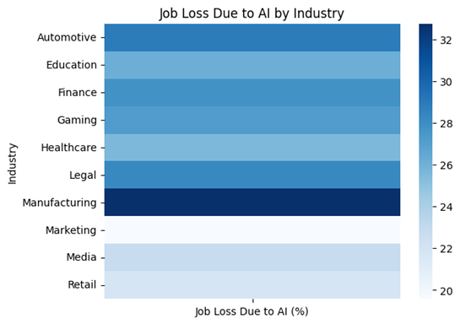
Section II
HEAT MAP
Heatmap is of mean Job Loss Due to AI (%) by industry with darker shades for greater loss. Manufacturing and Automotive are most impacted, while Marketing, Media, and Retail have lower impact.

Slide 9
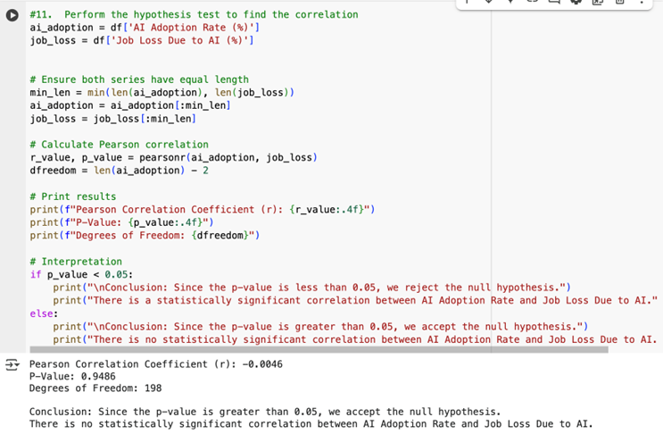
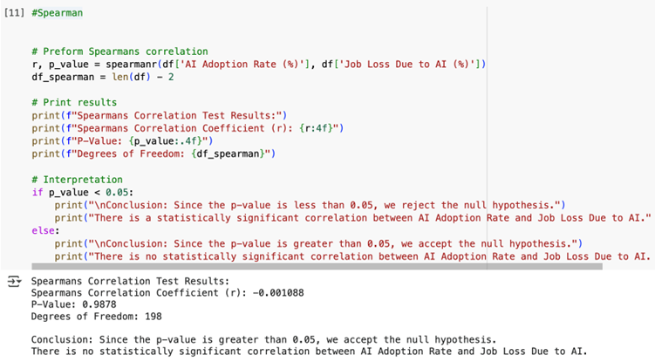
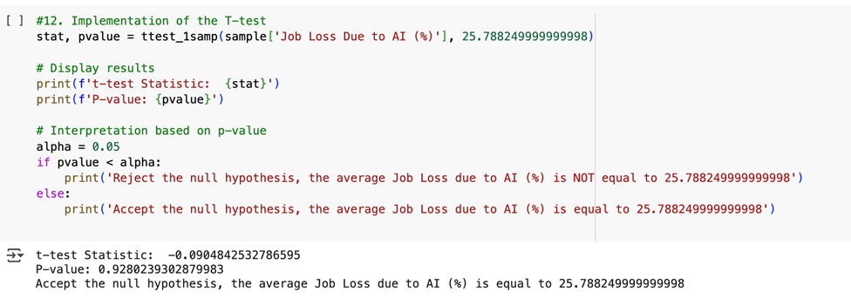
Section II
HYPOTHISIS TESTING
Both Pearson's and Spearman's correlation tests revealed no considerable correlation between Job Loss Due to AI (%) and AI Adoption Rate (%), and both had huge p-values of 0.9486 and 0.9878, respectively, thereby allowing us to accept the null hypothesis. Equally, one-sample t-test between the population mean (25.79%) and the sample mean also reported a p-value of 0.928, thereby revealing no significant difference between them.

Slide 10
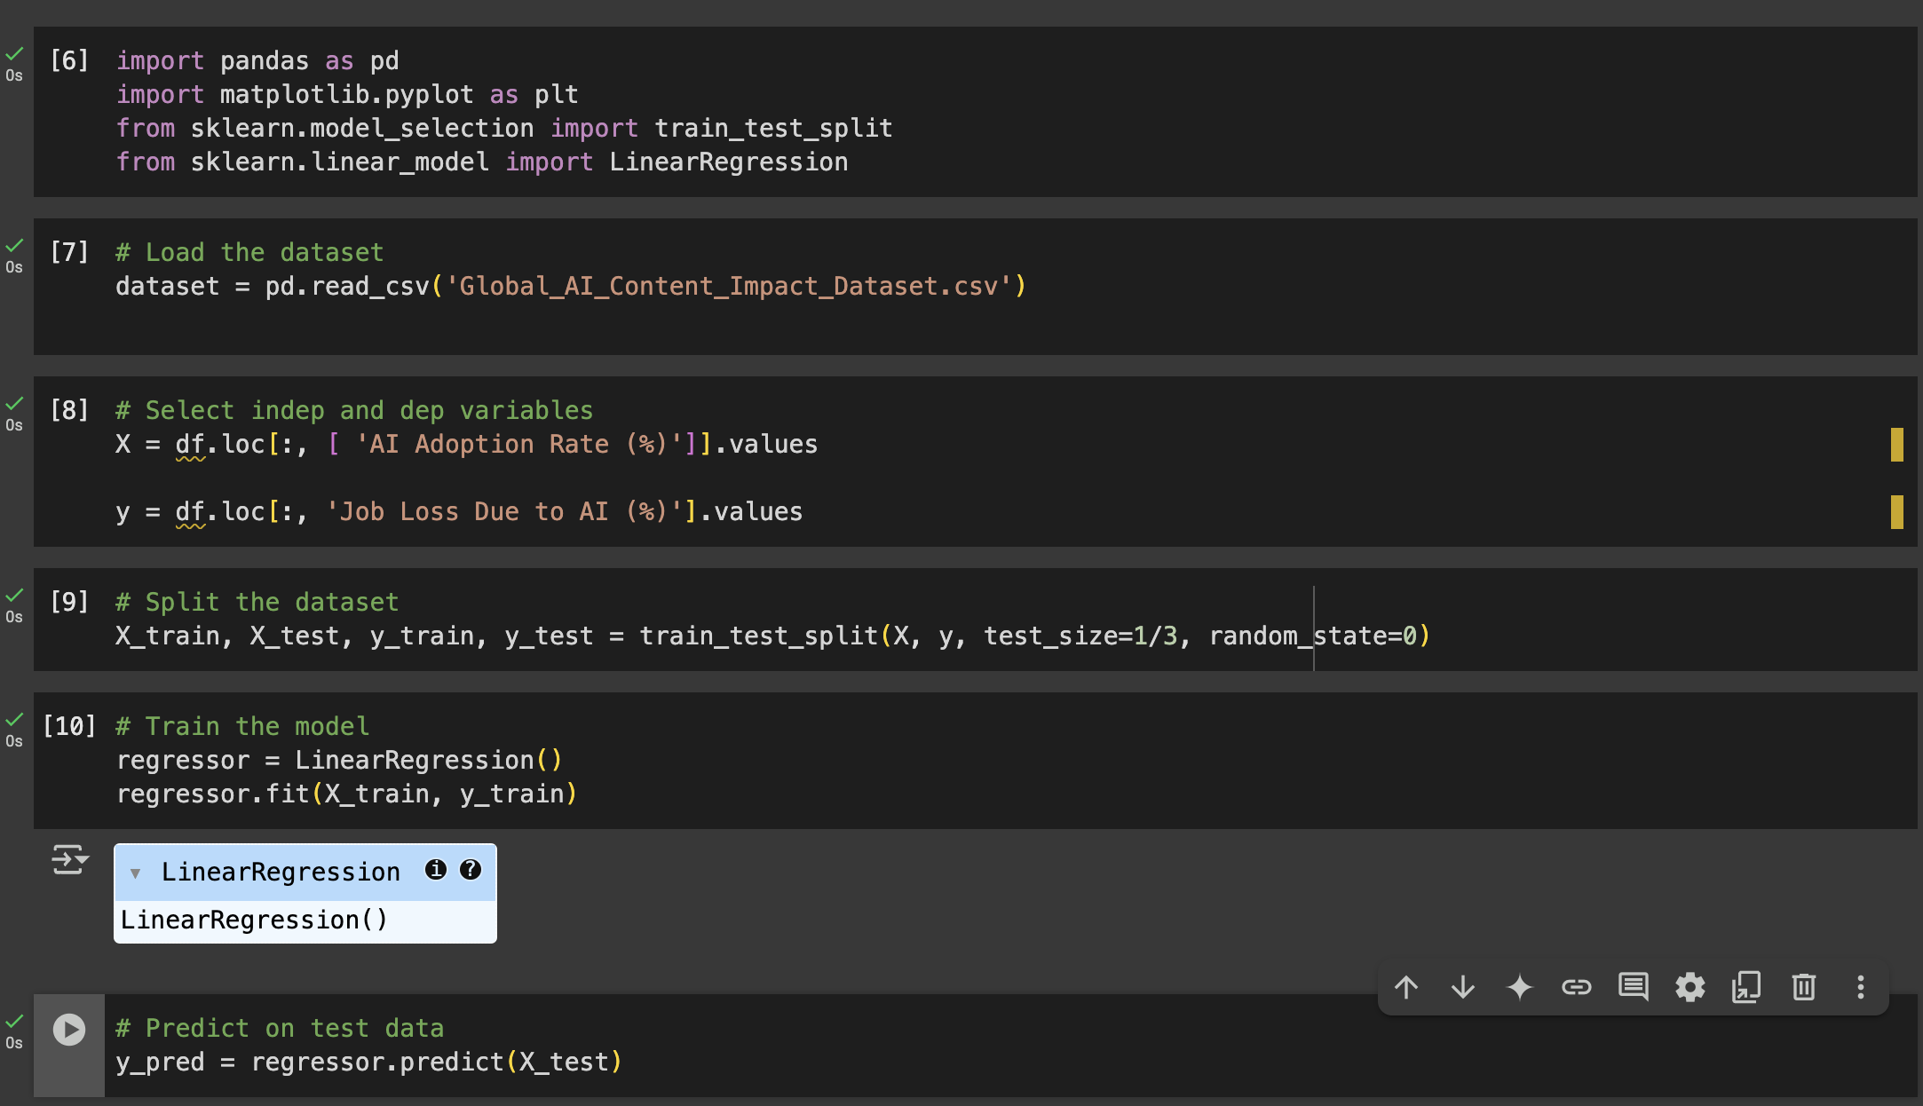
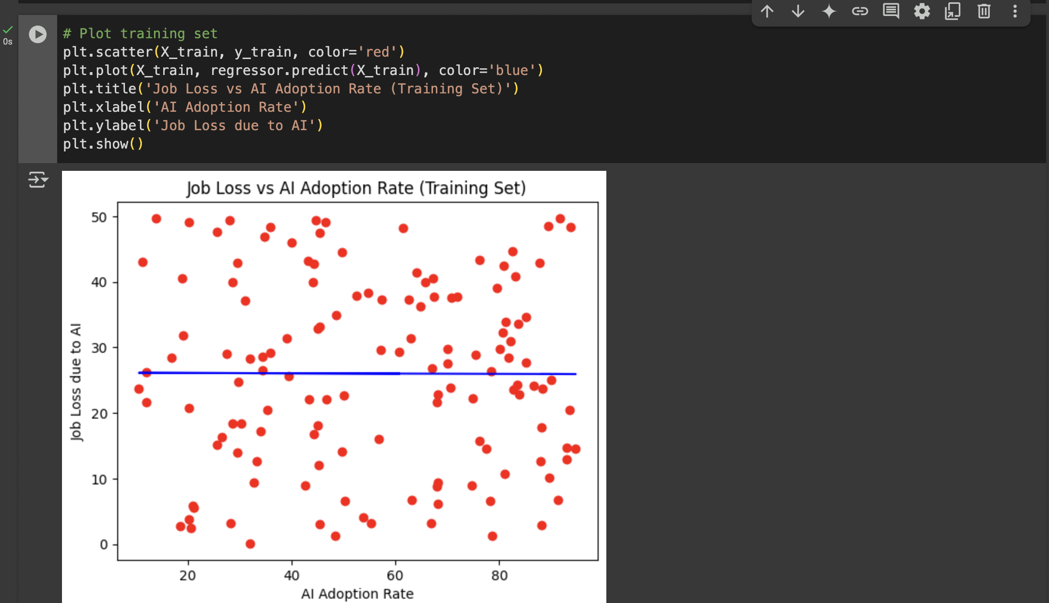
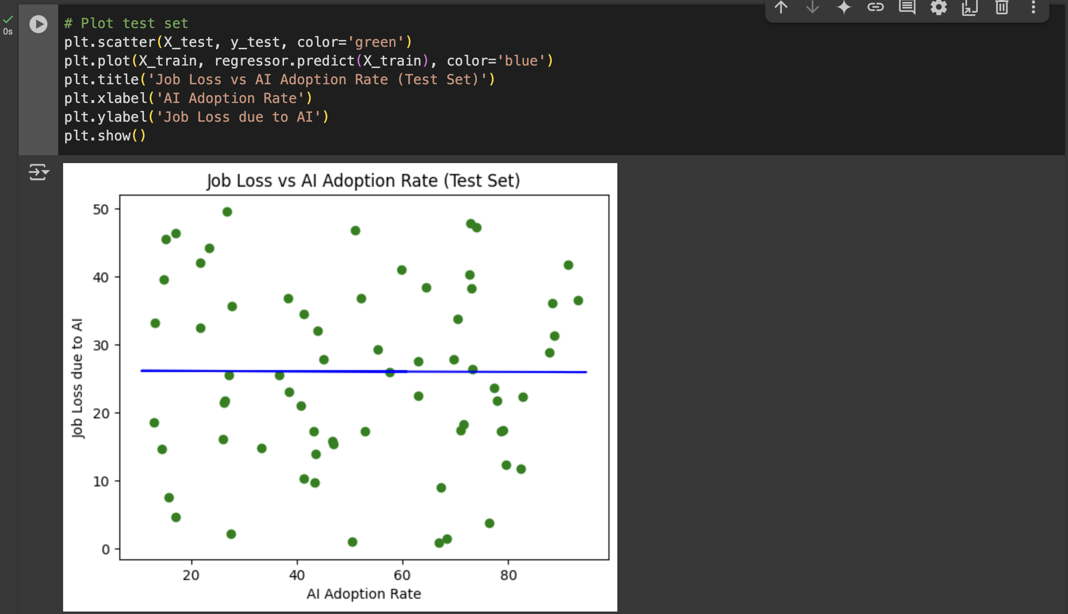
Section III
Build, Train, Develop and Evaluate using Simple Regression for chosen dataset.
We built a simple linear regression model to see how AI adoption affects job loss. The model was trained on past data and tested on new data, with predictions that were close to the actual results. we also created scatter plots to show the connection between AI adoption and job loss.

Slide 11
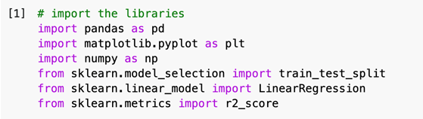
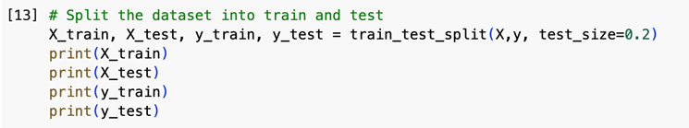
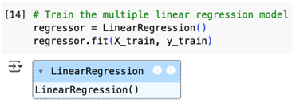
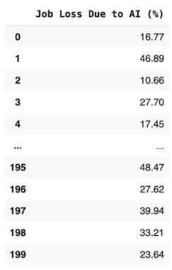
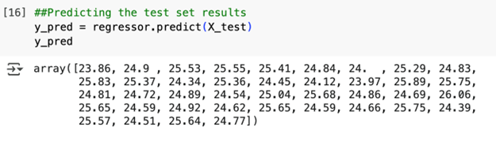
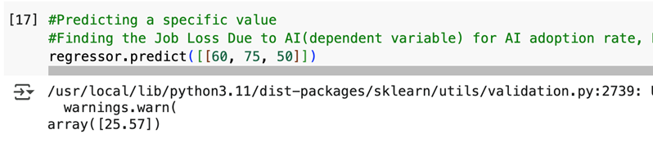
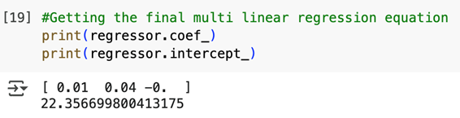
Section III
Developing a Script Using Multiple Linear Regression
We developed a Multiple Linear Regression model based on AI Adoption Rate, Consumer Trust in AI, and Human-AI Collaboration Rate for predicting Job Loss Due to AI (%). Predictions for test data and actual values closely agreed with good accuracy after the model was trained and tested. Input of type (AI Adoption: 60, Trust: 75, Collaboration: 50) returned a predicted job loss of 25.57%. The last regression equation, with coefficients extracted, can now be used to make predictions of AI-driven job loss.

Slide 12
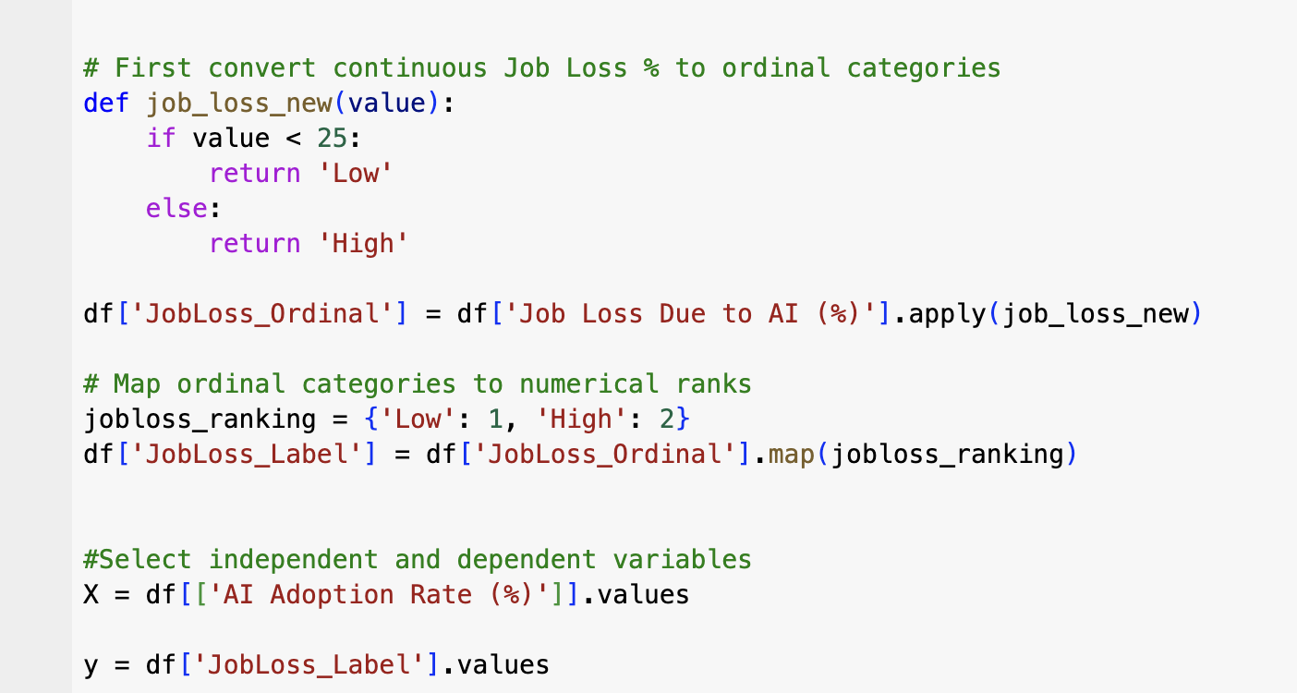
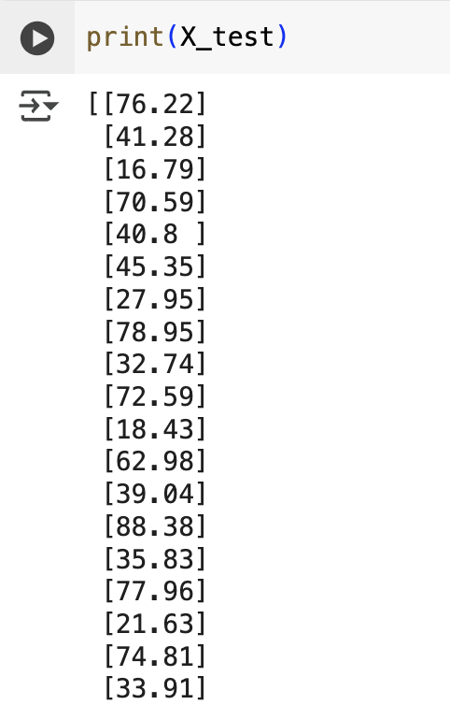
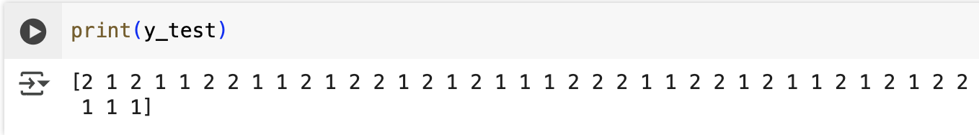
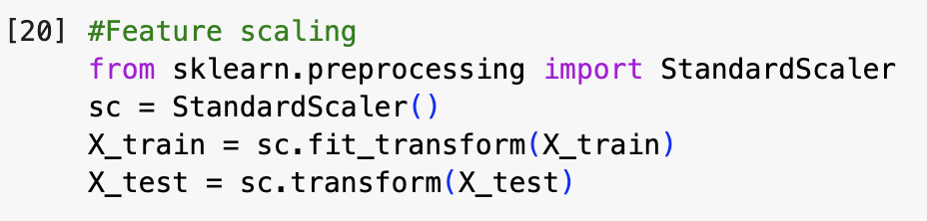
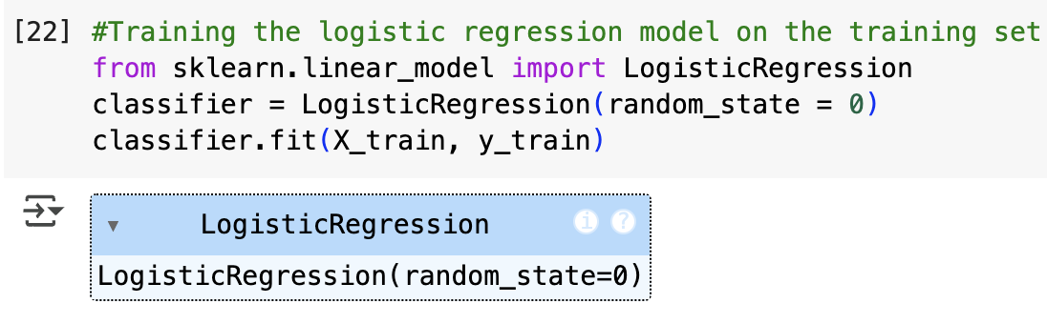
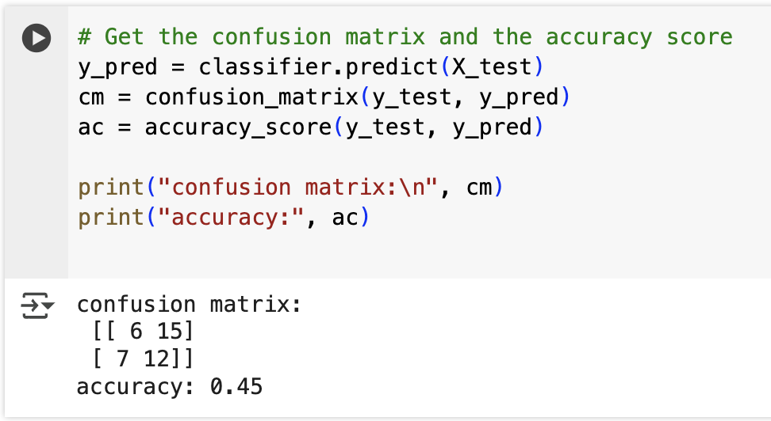
Section III
Classification Models to Predict Job Loss Due to AI (%)
We applied four classification models—Logistic Regression, KNN, Naive Bayes, and Decision Tree—to predict Job Loss Due to AI (%) as 'Low' or 'High'. This included the conversion of the quantitative job loss into categorical labels, and their marking with numeric values (0 and 1). In Logistic Regression, we trained the model on AI Adoption Rate (%) and validated it on a confusion matrix and accuracy score. The model was only 45% accurate, meaning that it correctly predicted job loss categories less than half the time.

Slide 13
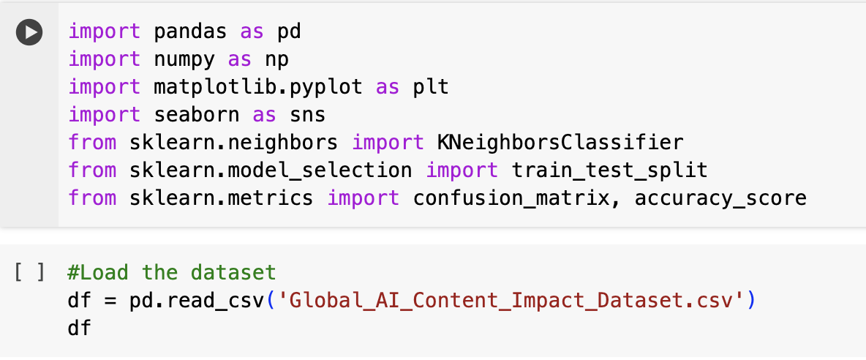
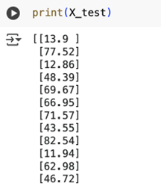
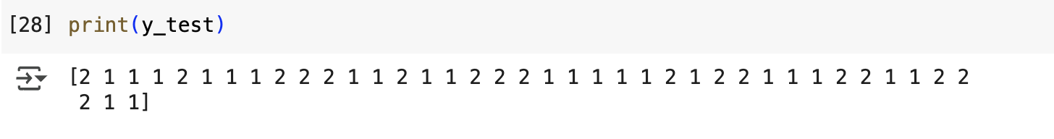
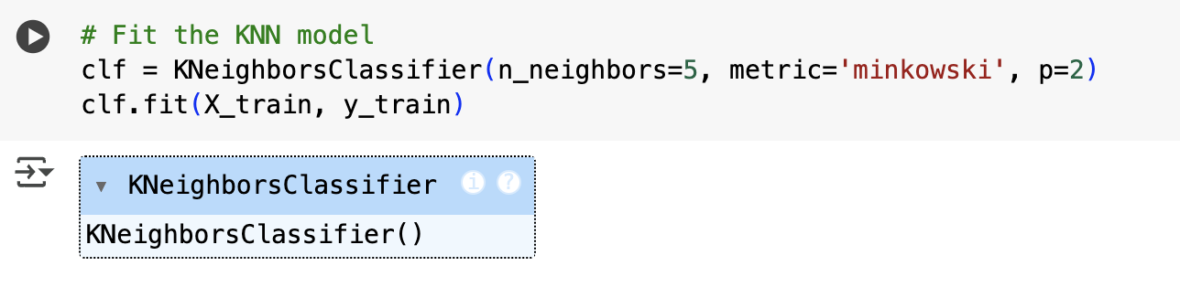
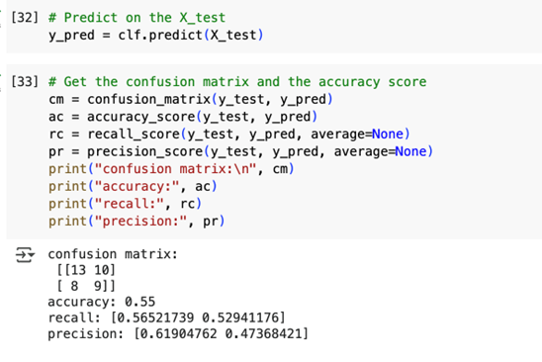
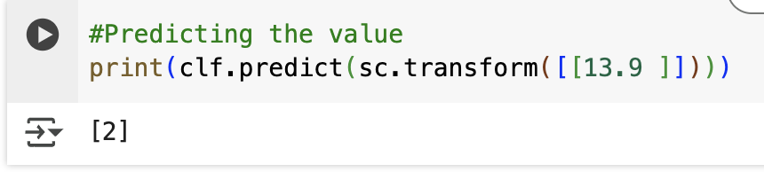
Section III
Classification – K-Nearest Neighbor (KNN)
We applied the K-Nearest Neighbors (KNN) classifier to forecast Job Loss Due to AI levels. We prepared the data and split it before fitting the model and checking its performance with an accuracy score and confusion matrix. The model was 55% accurate and got a test value correct, which is great in comparison with Logistic Regression.

Slide 14
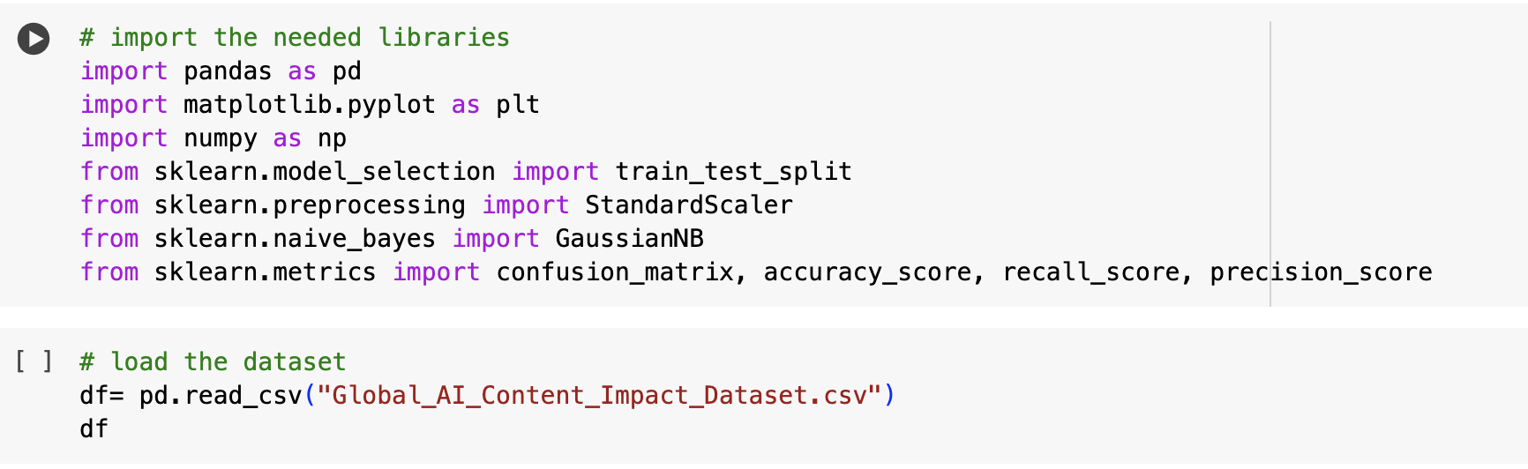
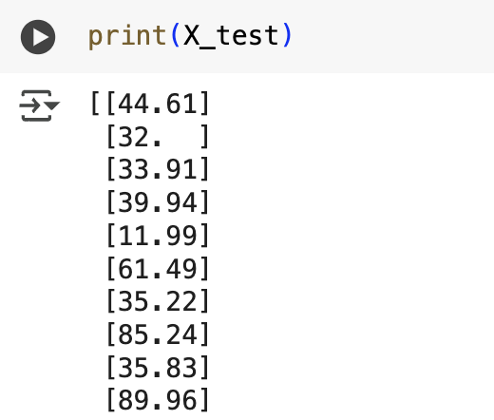
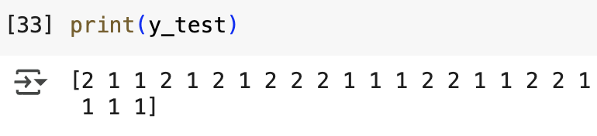
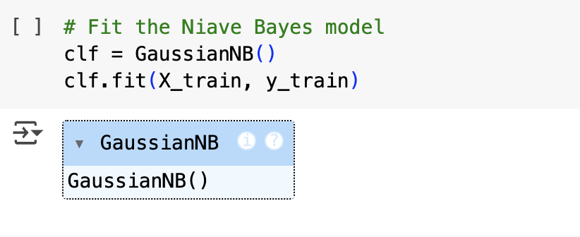
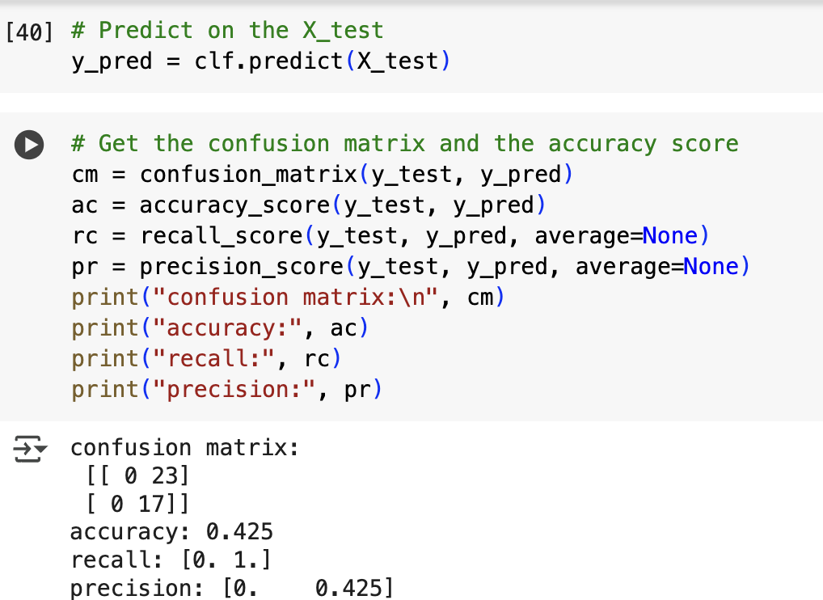
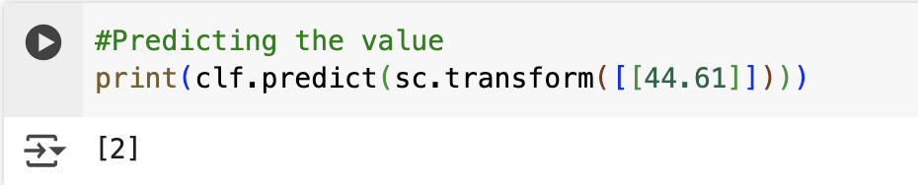
Section III
Classification – Naïve Bayes
We applied the Naïve Bayes classification model to predict Job Loss Due to AI levels, with the same data preparation procedure as before. The model, when trained, achieved an accuracy of 42.5%. Even though the accuracy was less, it correctly predicted a test value, which indicates that the model can still make accurate predictions in some cases.

Slide 15
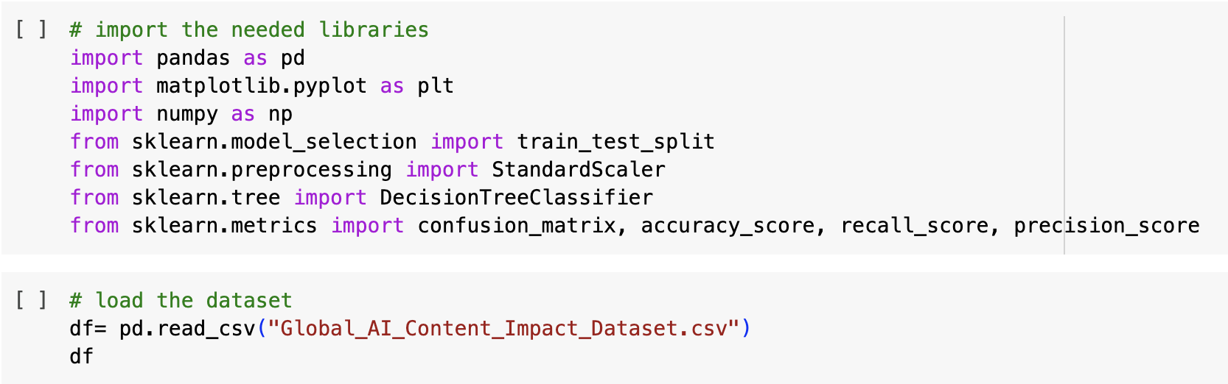
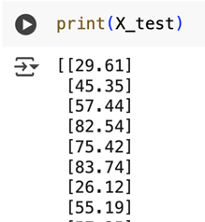
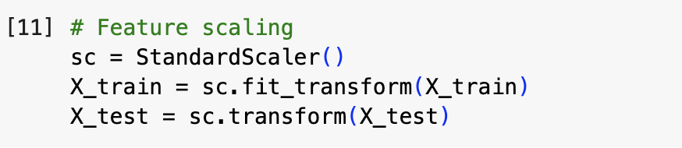
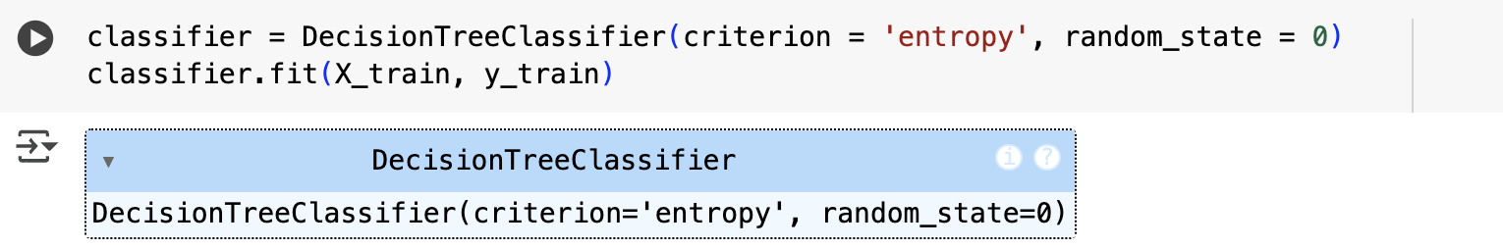
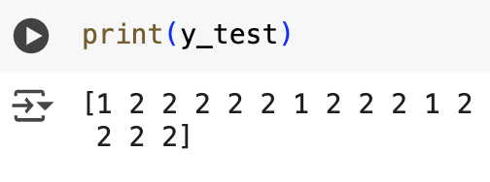
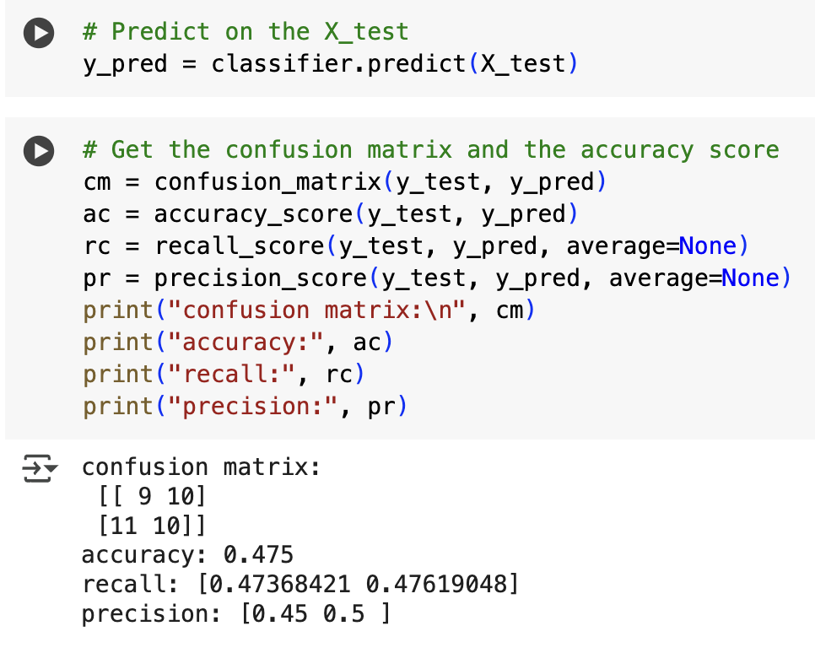
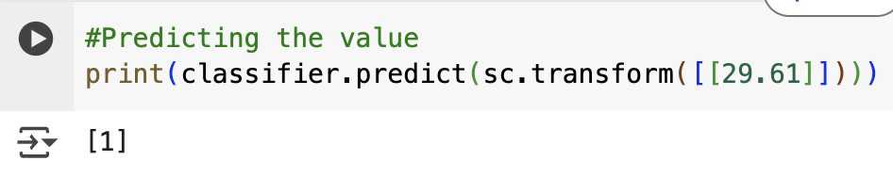
Section III
Classification – Decision Tree
We used a Decision Tree model to forecast Job Loss Due to AI levels under the same structure as all other models. The model was 47.5% accurate and correctly predicted a test value, performing fairly and validating it as capable of producing accurate predictions under certain circumstances.

Slide 16
Section III
Model | Errors | Accuracy
LR | 7 + 15 = 22 | 45%
KNN | 8 + 10 = 18 | 55%
NB | 0 + 23 = 23 | 42.5%
DT | 11 + 10 = 21 | 47.5%
Classification – Evaluation
To compare model performance, we evaluated Logistic Regression, Naïve Bayes, KNN, and Decision Tree using accuracy and total errors (false negatives + false positives). The lowest errors (18) and highest accuracy (55%) were produced by KNN, which shows that KNN is the best fit model for our data.

Slide 17
Section IIII
GIT HUB
We created a GitHub repository named *CIS-2423-PROJECT* to manage all project files for CLO1, CLO2, and CLO3. After uploading Python code, reports, and presentations—including Jupyter notebooks—we configured Git locally, cloned the repo, listed files with `ls`, pulled updates using `git pull origin main`, and modified files like `CLO2_PROJECT.ipynb` using the `nano` editor.

Slide 18
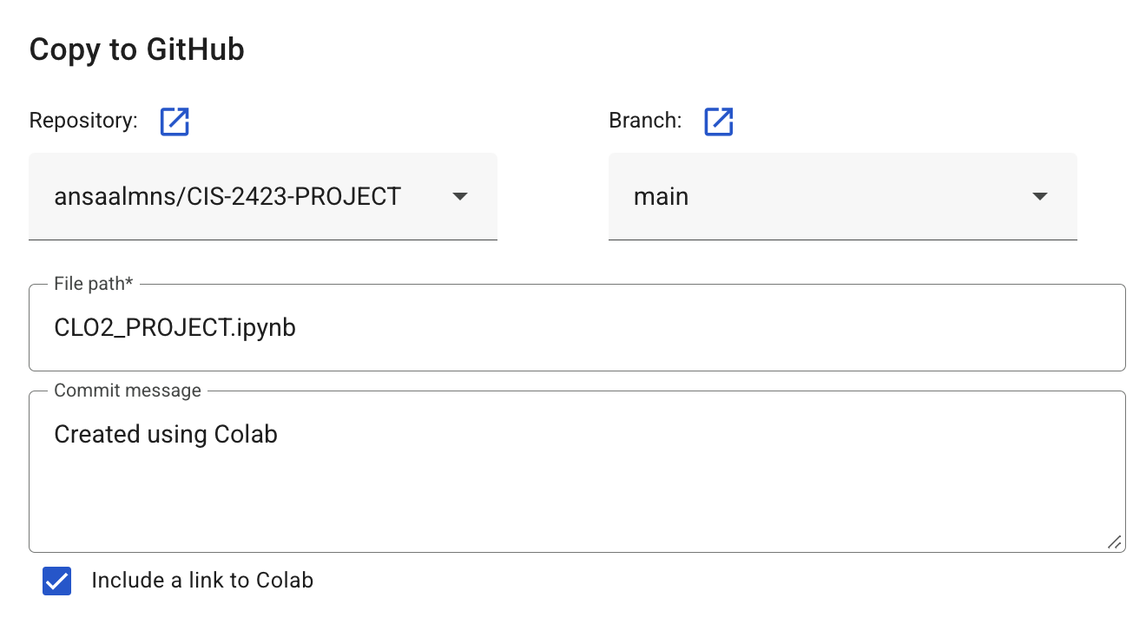
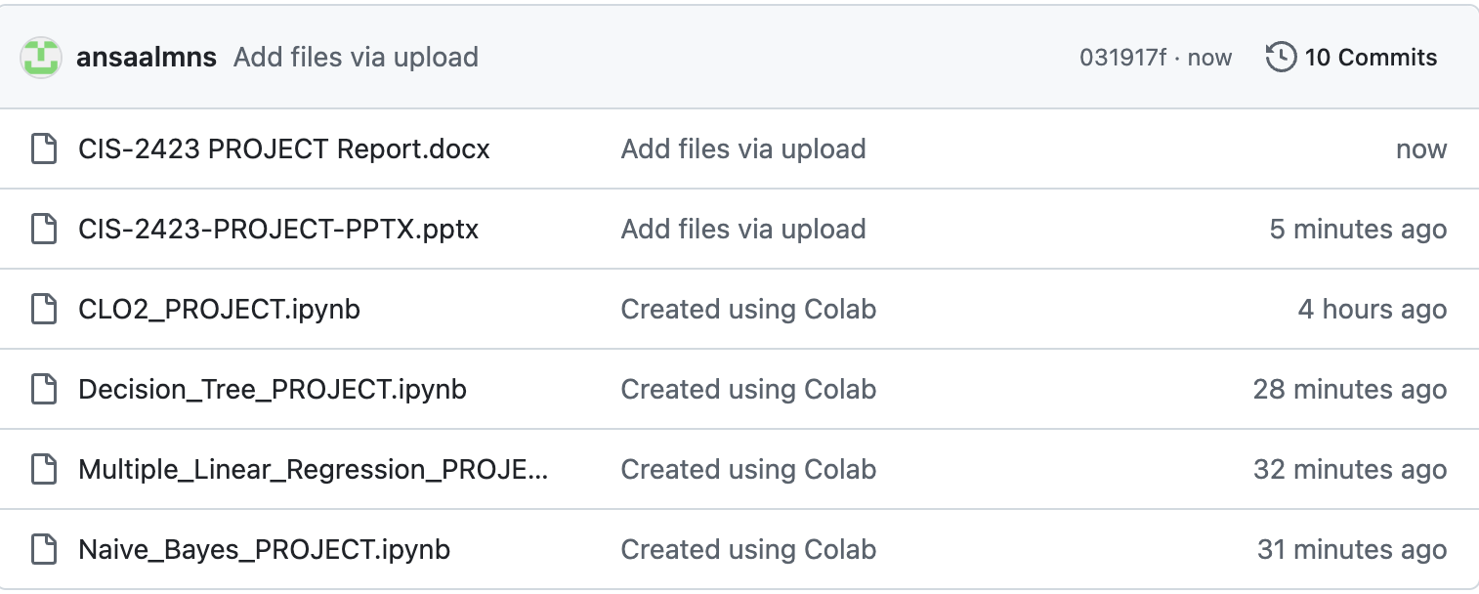
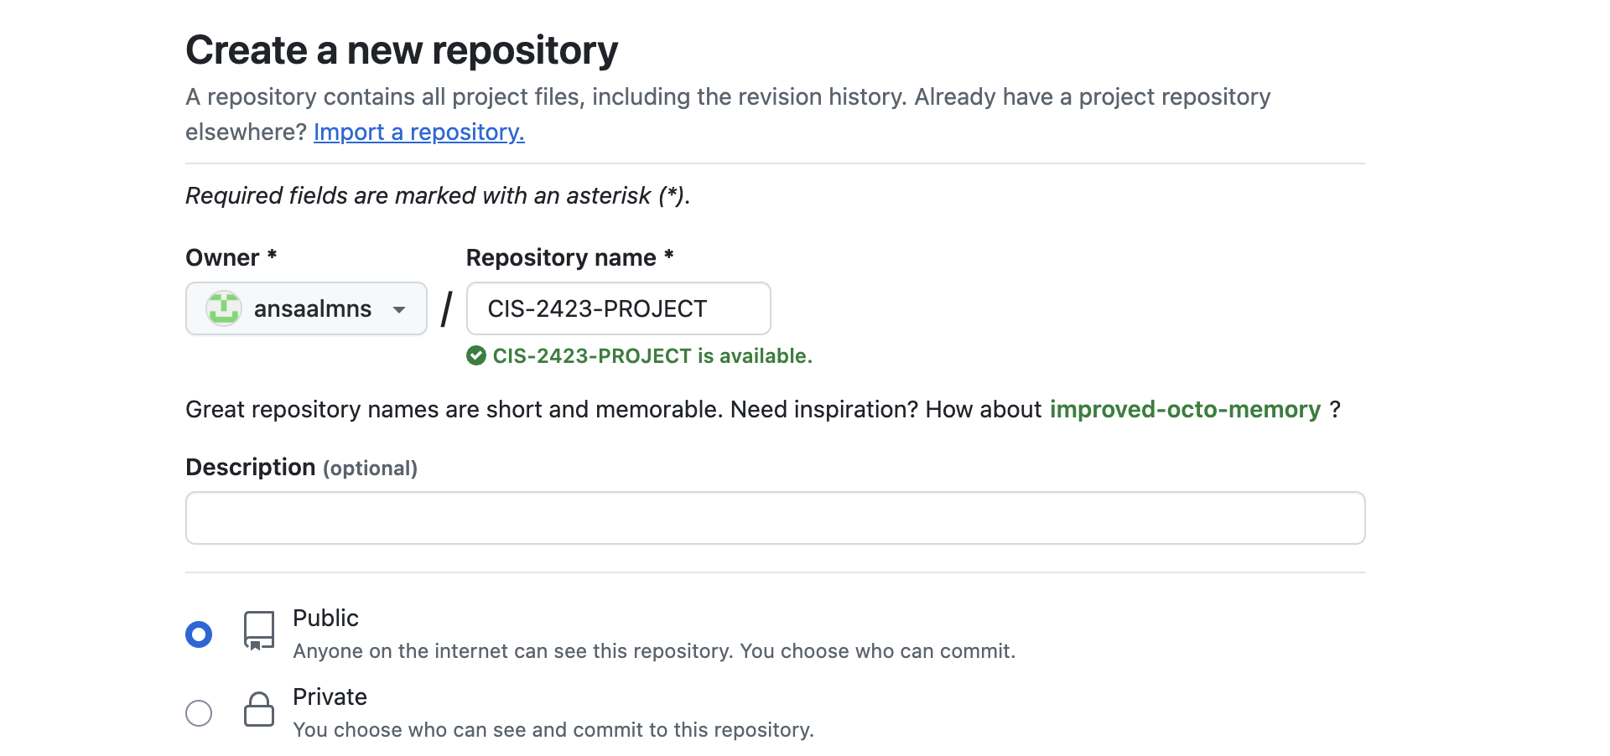
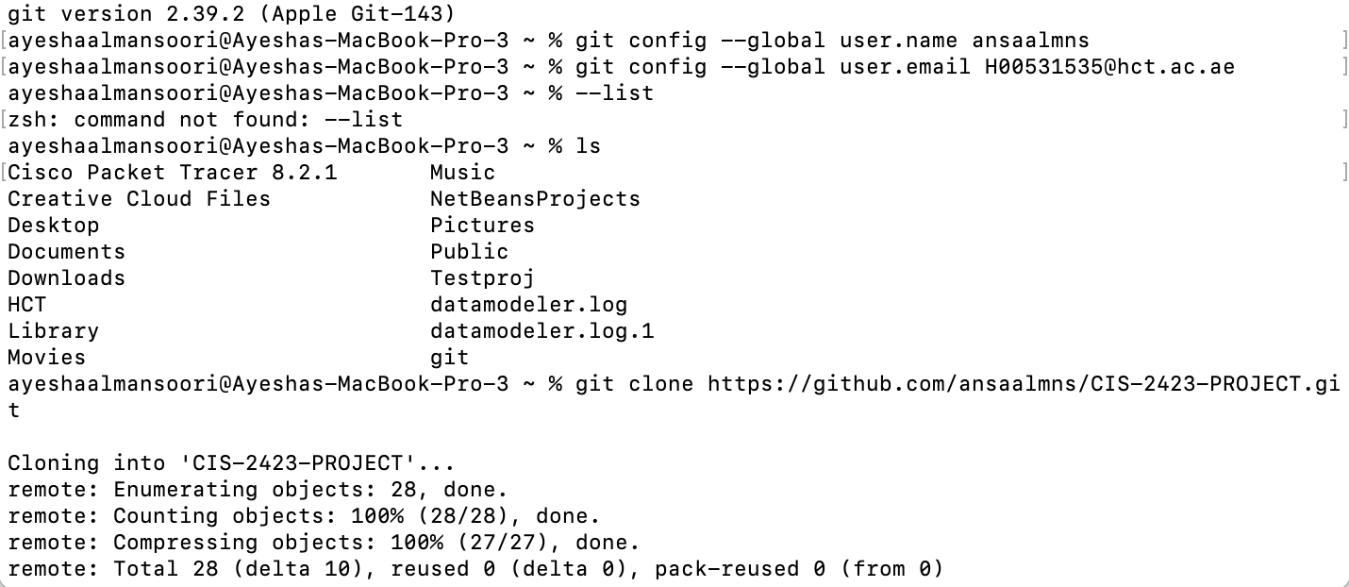
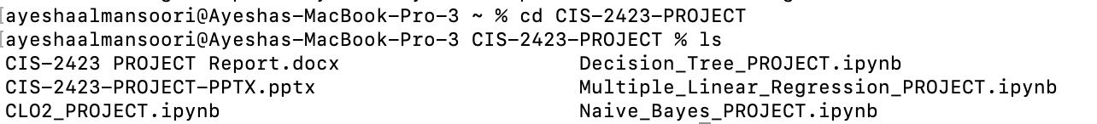
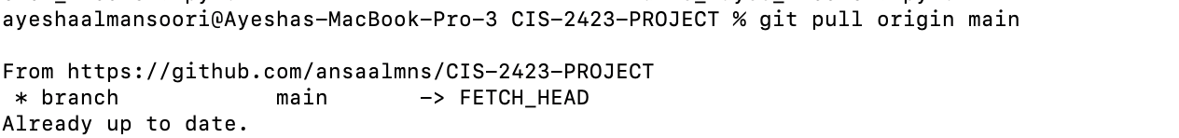

Section IIII
1- 2- 3-
4- 5- 6-
7-

